Slide 1
Throttle Copter
David DeTomaso
Gary Crum
Justin McDowell
Wes Edens

Slide 2
Description
Helicopter Flying Arcade Game
Button Controls the ‘flight’ of the helicopter and causes it to fly higher, gravity (letting go of button) causes it to fall
If the user hits the floor/ceiling/obstacle, game over
Level will shrink as time goes on, making it harder
Sound during game play
Using VGA Monitor

Slide 3
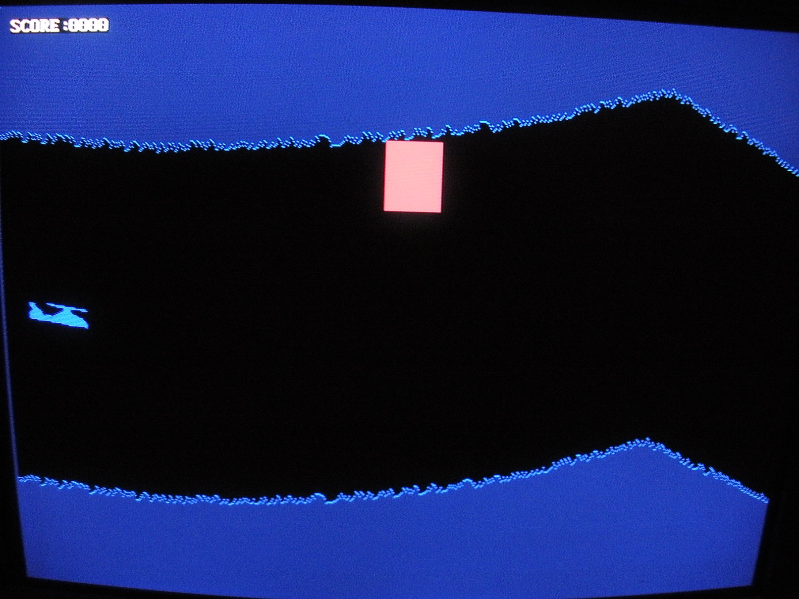
Description

Slide 4
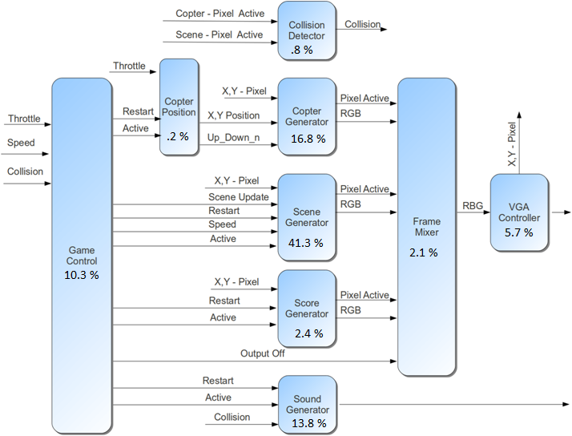
System Diagram
Number of Slices:
743 out of 4656 15%

Slide 5
Resource Utilization
 | ROMs | Adder | Counters | Registers | Comparators | Multiplexers | Xors | FSM
VGA Controller |  | 2 | 3 | 21 | 8
VGA Mixer |  |  |  | 8
Debounce |  | 1 |  | 23 | 1
Copter Gen | 2 | 5 |  | 62 | 4 | 2
Scene Gen |  | 10 |  | 152 | 9 |  | 1 | 1
Collision Detect |  |  |  | 3
Game Control |  | 1 | 1 | 38 |  |  |  | 1
Score | 2 | 5 | 1 | 9 | 8 | 5
Sound |  | 2 | 2 | 51 | 1 |  |  | 1
Copter Position |  |  | 1 | 1
Total | 4 | 26 | 8 | 368 | 31 | 7 | 1 | 3

Slide 6
Division of Work
David –
Scene Generation
Justin –
Audio
Gary –
Game Logic
Wes –
Scorekeeping

Slide 7
Score Module
Module that paints text on the screen
Needs a position to place the text
Needs a way of incrementing the numeric value
Outputs the RGB value for a given x,y pixel location in the screen

Slide 8
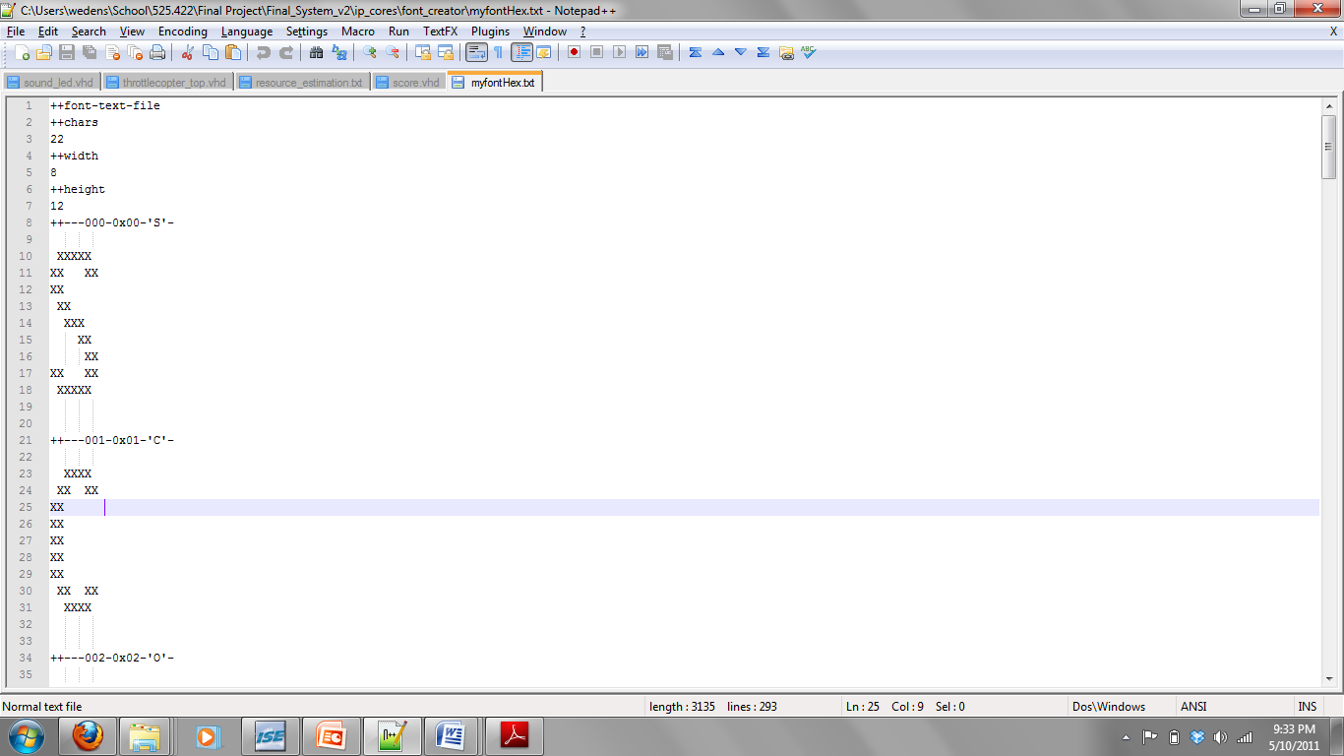
Font Rom Creation
Create a text file of each of the letters to be used.
Decide on a height/width of each char
Create a mask for each character
Blank space means 0
Any other char mean 1
Create a postscript font file from this file (c code)
Perl script to create the .coe memory initialization file
c code obtained at: http://nafe.sourceforge.net/

Slide 9
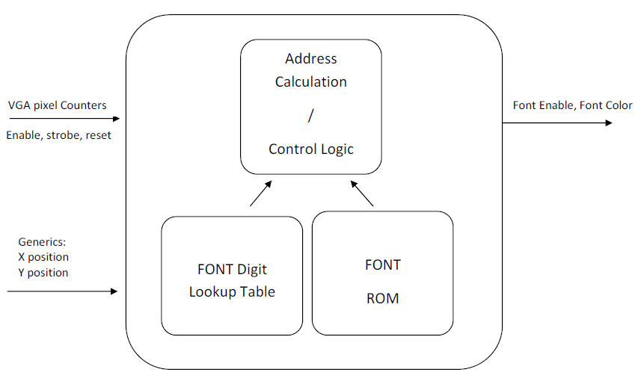
Score Module

Slide 10
Scene Generation - Storage
In total this will require 64 bits per column:
Cave Top and Bottom have extra 12 bits of decimal precision so that arbitrary slopes can be represented in the lines that connection points on the ceiling and floor.
63…42
41…20
19…10
9…0
Cave
Top
Cave
Bottom
Block Top
Block
Bottom

Slide 11
Scene Generation - Readout
Offset
Row
<=
Ceiling
Col
Floor
Row
>=
Block Top
OR
Row
Pixel is Green
>=
Block Bottom
Row
<=

Slide 12
Scene Generation - Writing
A state machine handles the writing to block memory to add columns.
Triggered by an update pulse between frames
PreStart
Start
S2
S3
Waiting
S5
S4

Slide 13
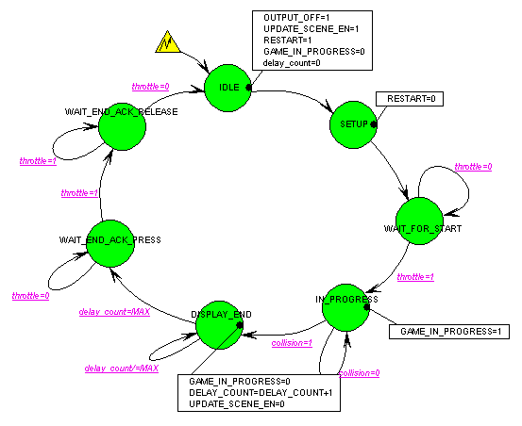
Game Control FSM
Seven States
Allows game setup after Reset and New Game
Starts and Stops other Modules
Provides 'safe' continuation for New Game

Slide 14
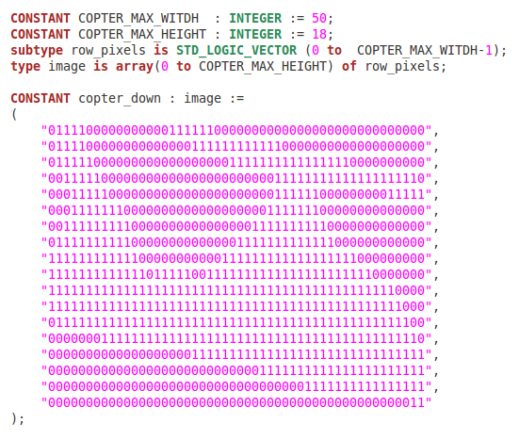
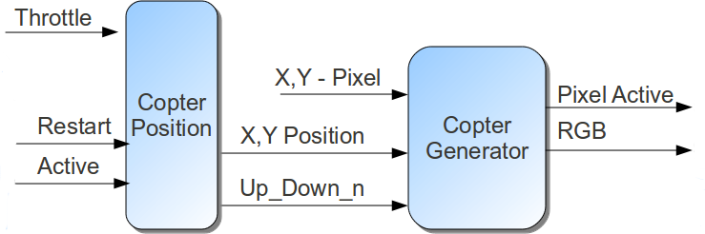
Copter Generation
Two Image Constants – Up and Down
Process Detects when Pixel is in Copter 'Box'

Slide 15
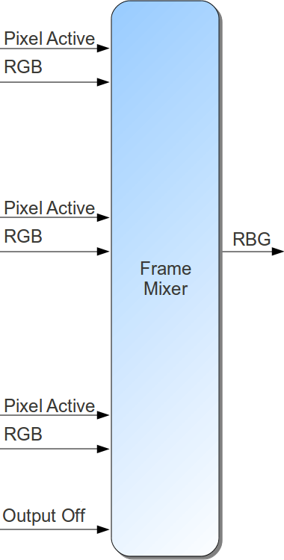
VGA Mixer
Layers Graphics:
0 – Implied Background
1 – Scene/Obstacle
2 – Copter
3 - Score

Slide 16
Sound and LED's
Features
Jaws theme music during game play
Scrolling LED's during game play
“Game Over” sound triggered by crash
All LED's flashing at end of game

Slide 17
Sound and LED's
Components
Digital Clock Manager
Digital to Analog Converter
Sine Lookup Table
Lowpass Filter

Slide 18
Sound and LED's
Utilization
One of four DCM's (25%)
13 of 232 IOBs (5%)
2 of 24 GCLKs (8%)
One six state FSM

Slide 19
Questions
?

